Slide 1


GDP PER CAPITA PREDICTION SYSTEM
Supervised By:
Mr. Abdul Qudus Abbasi
Presented By:
Rafia Shafique-04161813013
Hamad Khan-04161813035
Gulshan Kumar-04161813041

Slide 2
Agenda
Introduction
Proposed System
System Requirements
Hardware and Software Requirements
Data Selection
Data Preprocessing
Data Visualization
Model Development
Model Deployment
User Interfaces
Conclusion and Future Work

Slide 3
Introduction
What is GDP?
Gross domestic product (GDP) is the total monetary or market value of all the finished goods and services produced within a country’s borders in a specific time period.
What is GDP per capita?
GDP per capita is a measurement of the GDP per person in a country’s population.
The formula for calculating GDP per capita is given below:
GDP per capita = GDP of the Country / Population of that Country

Slide 4
Problem Statement
Gross Domestic Product (GDP) plays a major role to tracks the health of a country economy.
Due to GDP importance on economic growth, it is mandatory to provide a system that is used to predict the growth of the country.
Machine Learning can play a big role in order to predict the growth of Pakistan.

Slide 5
Proposed Solution
In order to predict the GDP per capita of a country.
We have tried different Machine Learning Models and trained it on historical GDP per capita data.
And test it on test data in order to get higher accuracy.
The end user can easily predict the GDP per capita of a country on providing the required criteria for prediction.

Slide 6
System Requirements
Functional Requirement
The new system will be web base application which will allow all users to enter the specific region, country, and all other attributes) to get the predicted results.
Non-Functional Requirement
Software requirements specifications are included in the non-functional requirements of the GDP per capita prediction system, which contains various processes, namely Security, Performance, Maintainability, and Reliability.
Hardware Requirements
RAM: 8GB
Hard disk: 565GB Hard Disk
Processor: Intel® Core™ m3-7Y30 @1.00GHz 1.61 GH

Slide 7
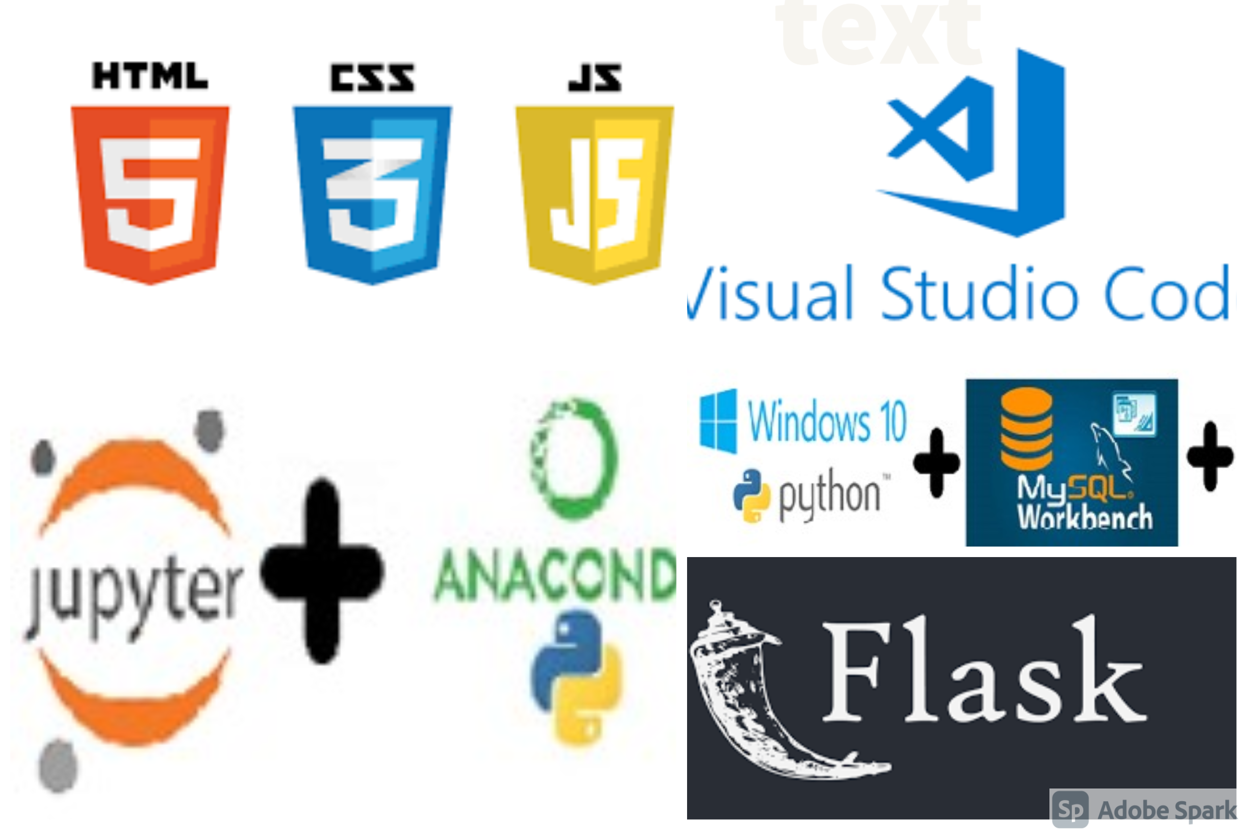
Software Requirements
Operating System Windows (10)
Languages Python (3.8.5)
Javascript
Bootstrap5
HTML
CSS
MYSQL
Complier Jupyter Notebook(6.1.4)
Spyder(4.1.5)
Environment Anaconda (4.9.2)
Visual Studio code(1.53.2)
MYSQL Woirkbench
Framework Flask

Slide 8
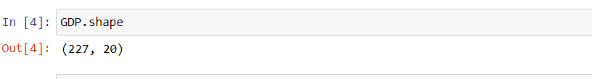
Dataset
We pick dataset from Kaggle Website.
Below are the link of dataset.
Retrieved from: https://www.kaggle.com/datasets/fernandol/countries-of-the-world
Shape of dataset (Total dataset columns and Rows)

Slide 9
Features of Dataset
Country
Region
Population
Area
Population density
Coastline
Net migration
Infant Mortality
Industry
Literacy
Phones
Arable
Crops
Other
Climate
Birthrate
Death rate
Agriculture
GDP per capita
Service

Slide 10
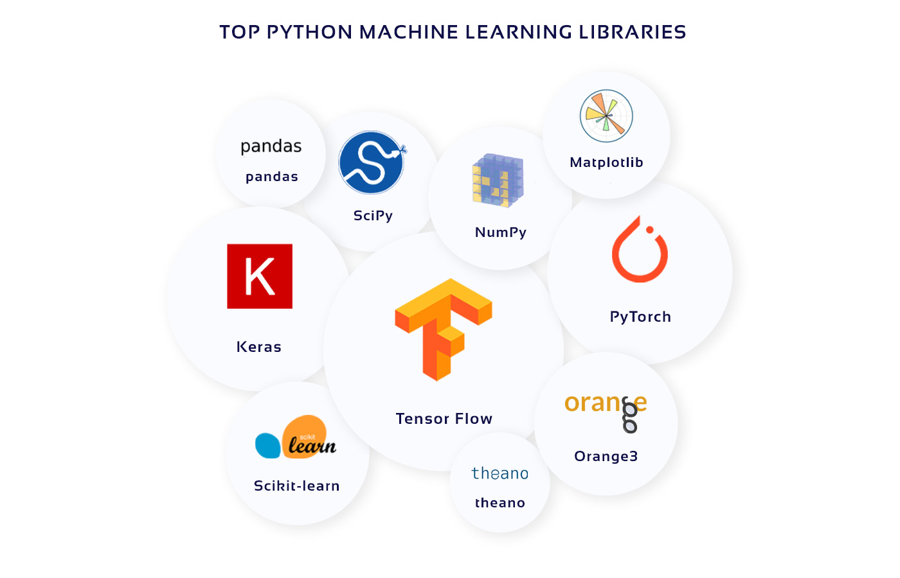
Libraries
Numpy
Pandas
Scipy
Matplotlib
Seaborn
Scikit-learn

Slide 11
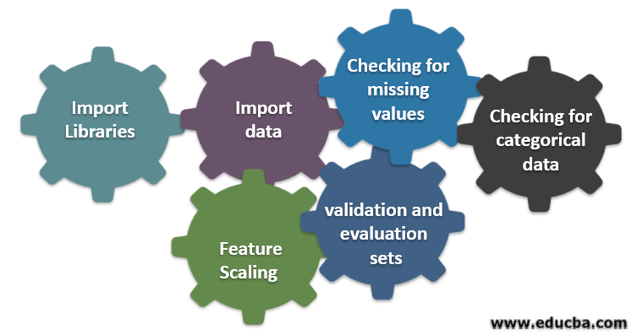
Data Preprocessing
Data preprocessing is a process of preparing the raw data and making it suitable for a machine learning model.
It is the first and crucial step while creating a machine learning model.

Slide 12
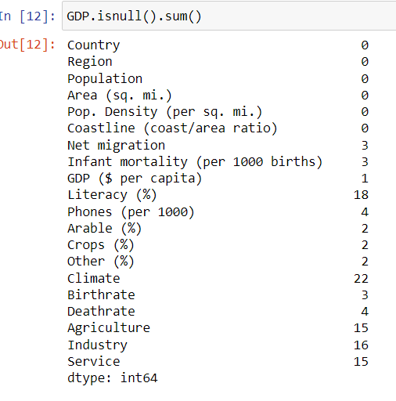
Determine null values

Slide 13

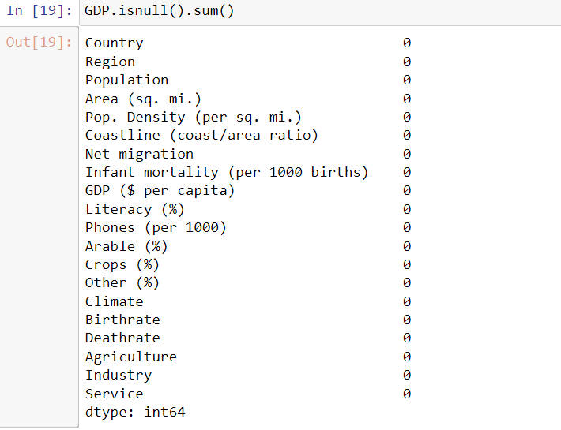
Determine duplicate values
Dataset after replacing Null values

Slide 14
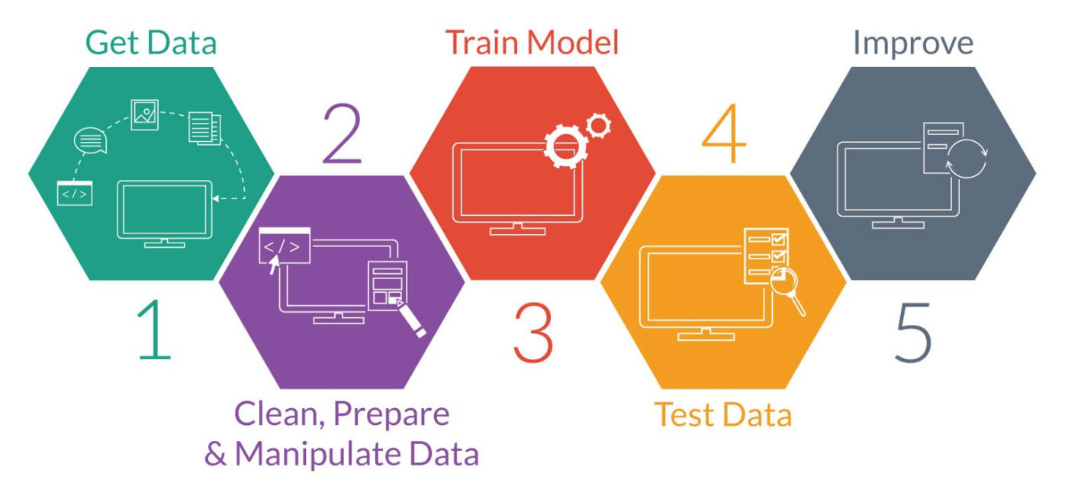
Machine Learning
Machine learning is an application of artificial intelligence (AI) that provides systems the ability to automatically learn and improve from experience without being explicitly programmed.

Slide 15
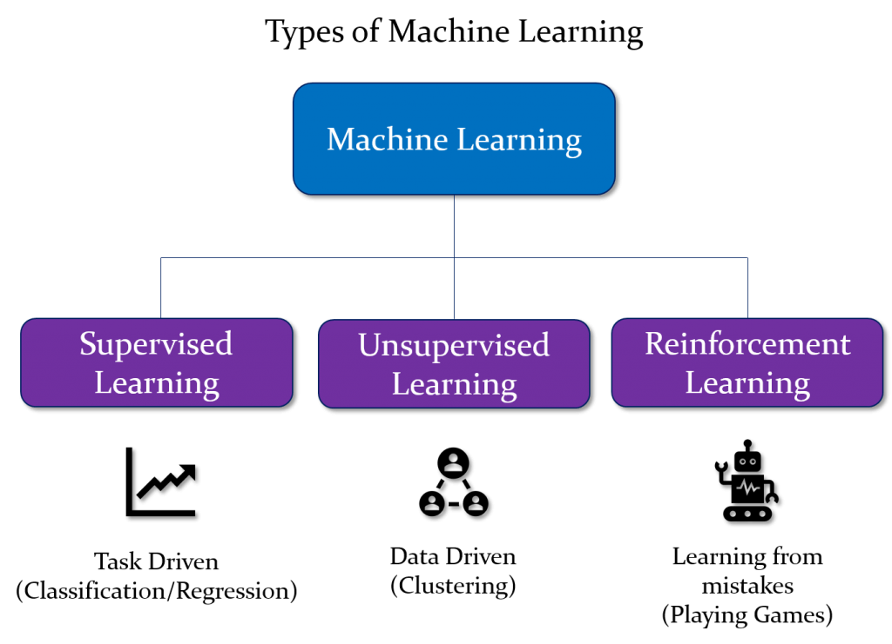
Types of Machine learning

Slide 16
Supervised Machine Learning
It is a subcategory of machine learning and artificial intelligence.
It is defined by its use of labeled datasets to train algorithms that to classify data or predict outcomes accurately.
Supervised learning can be separated into two types of problems classification and regression.

Slide 17
Regression
There are many supervise machine learning algorithms present but according to our need we will use following ones.
Simple Linear Regression
Multiple Linear Regression
Support Vector Regression
Ridge Regression
Lasso Regression
Polynomial Regression
Decision Tree Regression
Random Forest Regression
Gradient Boosting Regression

Slide 18
Model development process
The model development process consist of the following steps.
Divide the data into testing and training data
Model fitting with training data
Model prediction with testing data
Model evaluation based on metrices

Slide 19
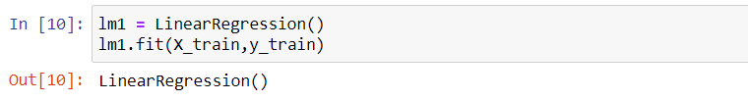
Model development process through Multiple Linear Regression
Splitting data into training and testing sets
Model fitting on training data

Slide 20
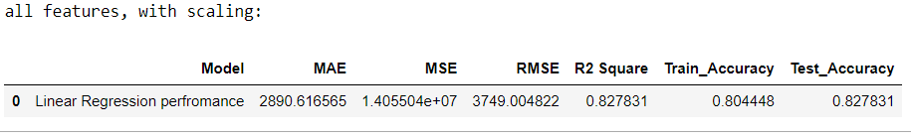
Cont..
Model prediction on testing data
Model evaluation(performance)

Slide 21
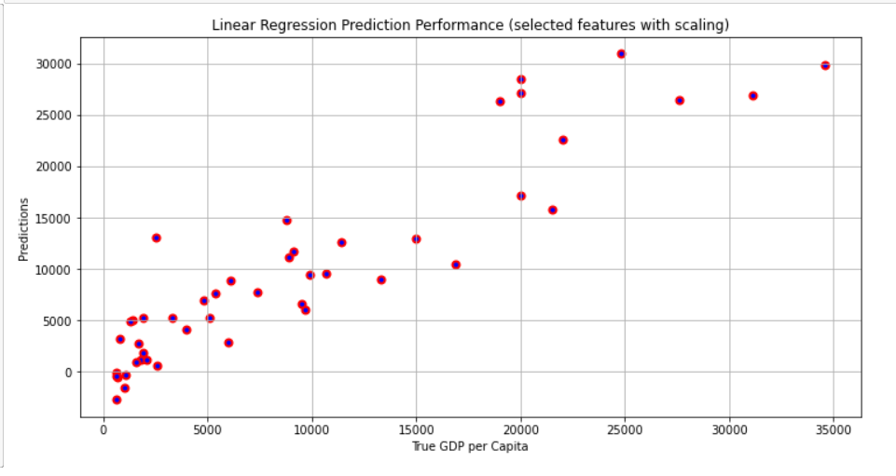
Cont..
Multiple linear regression prediction performance(Graph)

Slide 22
All Model Accuracies(table)
Evaluation of all algorithms
Model | MAE | MSE | RMSE | R2 Square | Test Accuracy
Linear Regression | 2890.67 | 1.41e+07 | 3749.00 | 0.83 | 0.83
Lasso Regression | 2891.21 | 1.41e+07 | 3752.03 | 0.82 | 0.82
Ridge Regression | 2890.74 | 1.40e+07 | 3737.19 | 0.83 | 0.83
Polynomial Regression with Linear Regression | 5526.79 | 1.15e+11 | 8383.05 | 0.13 | 0.13
Polynomial Regression with Lasso Regression | 5847.97 | 6.92e+07 | 8319.75 | 0.15 | 0.15
Polynomial Regression with Ridge Regression | 5503.63 | 6.99e+07 | 8361.70 | 0.14 | 0.14
Decision Regression Tree | 3512.82 | 2.57e+07 | 5073.50 | 0.68 | 0.68
Random Forest | 2236.17 | 9.61e+06 | 3100.80 | 0.88 | 0.88
Gradient Boosting | 2174.21 | 9.31e+07 | 3051.41 | 0.89 | 0.89
SVR | 7066.83 | 9.61e+07 | 9806.93 | -0.18 | -0.18

Slide 23
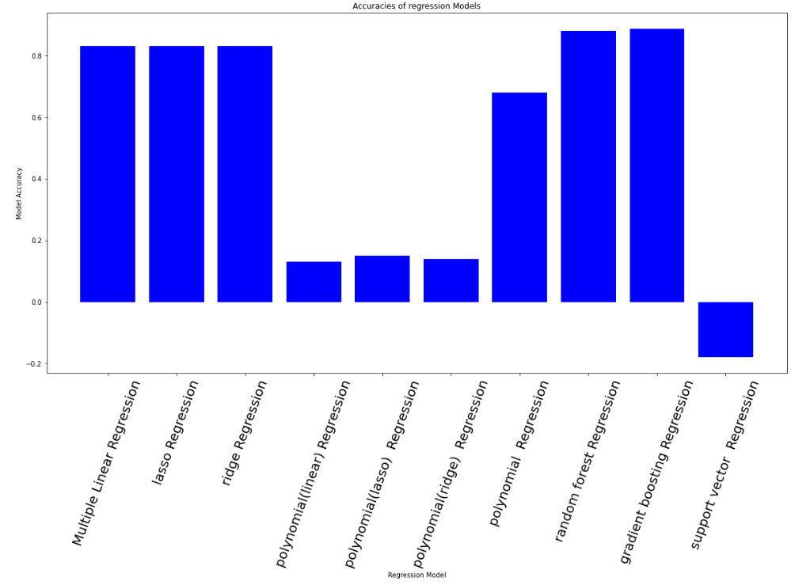
All Model Accuracies(Graph)
Accuracies of Regression model

Slide 24
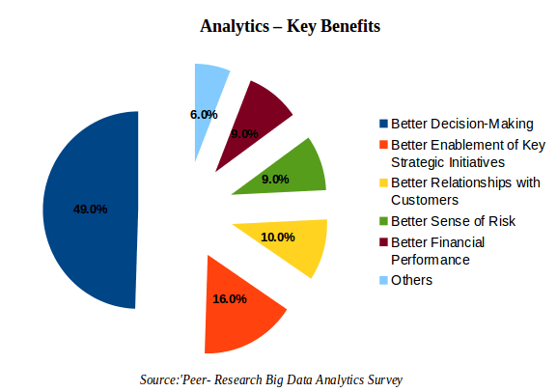
Data Analysis and Visualization
Data analysis is defined as a process of cleaning, transforming, and modeling data to discover useful information for business decision-making.
The purpose of data analysis is to extract useful information from data and take a decision based on the data analysis.
Data visualization is the graphical representation of information and data.
By using visual elements like charts, graphs, and maps, data visualization tools provide an accessible way to see and understand trends, and patterns in data.

Slide 25
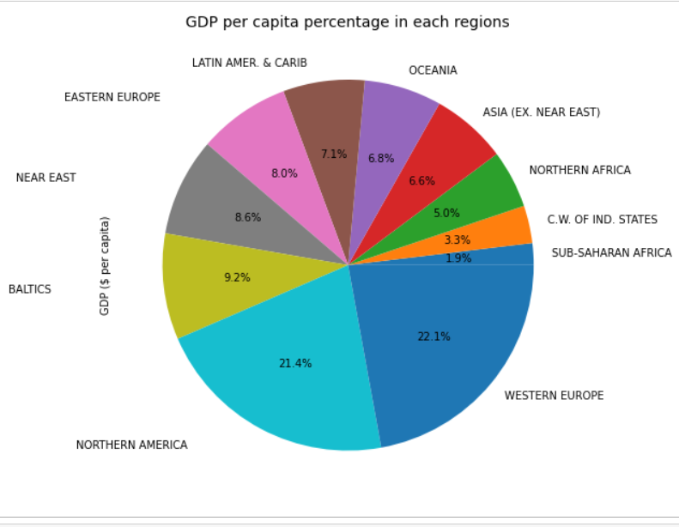
Cont..
Regional Analysis
Comparison of GDP per capita of regions by percentage

Slide 26
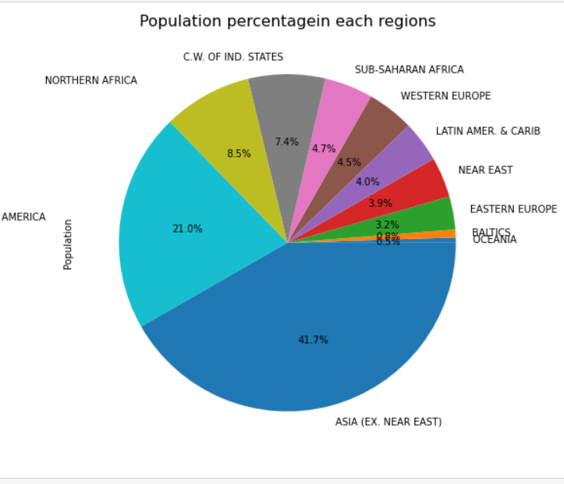
Cont..
Comparison of Population of regions by percentage

Slide 27
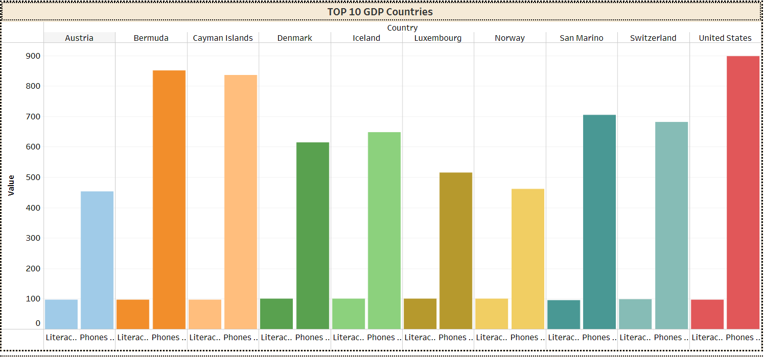
Analysis and Comparison between top 10 GDPs countries and lowest 10 GDPs countries based on attributes
Analysis and comparison based on literacy rate and cell phone user

Slide 28
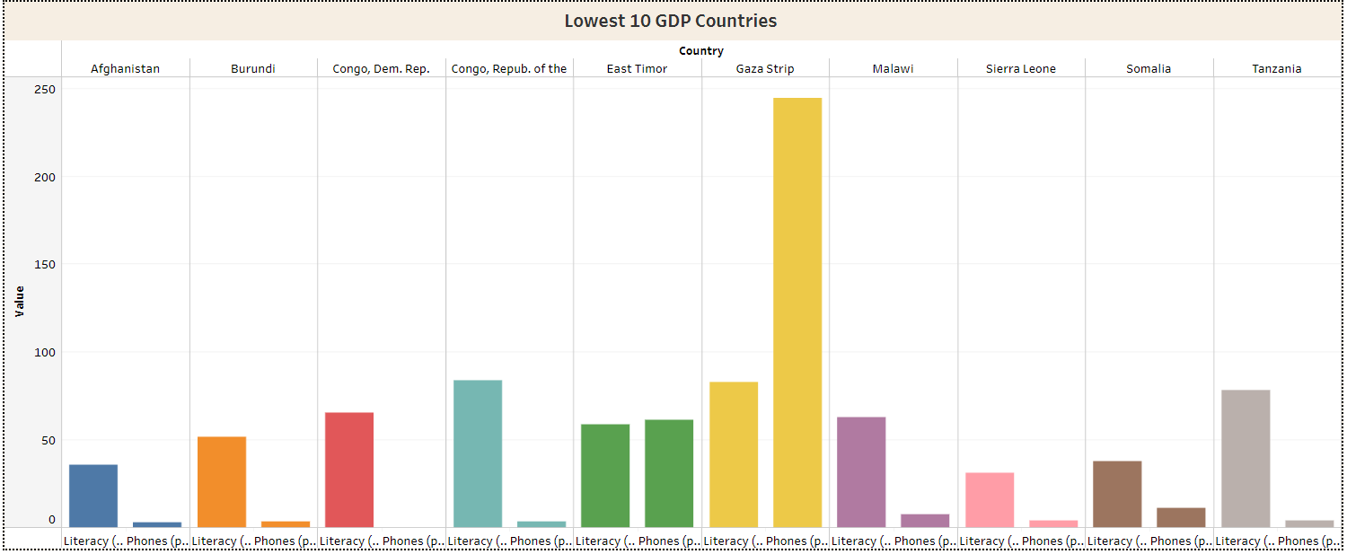
Cont..
Literacy rate and cell phone user of lowest 10 GDPs countries

Slide 29
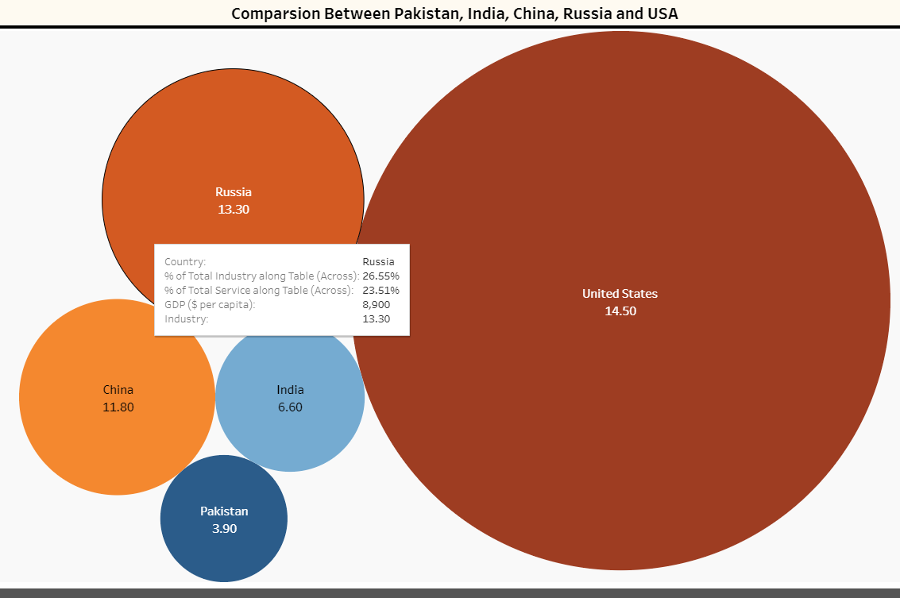
Analysis and Comparison between Pakistan, India, China, USA, and Russia

Slide 30
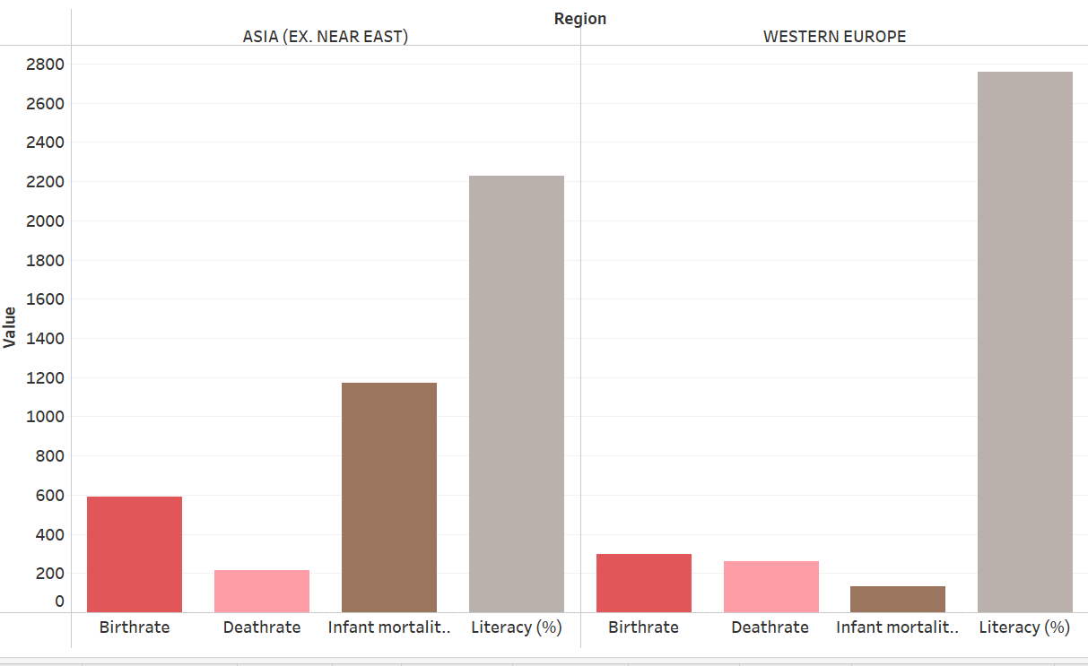
Analysis and comparison of Asia and Western Europe region

Slide 31
Model deployment
For the deployment of our model, We use the flask.
Flask is a web framework.
Flask provides us with tools, libraries, and technologies that allow you to build a web application

Slide 32
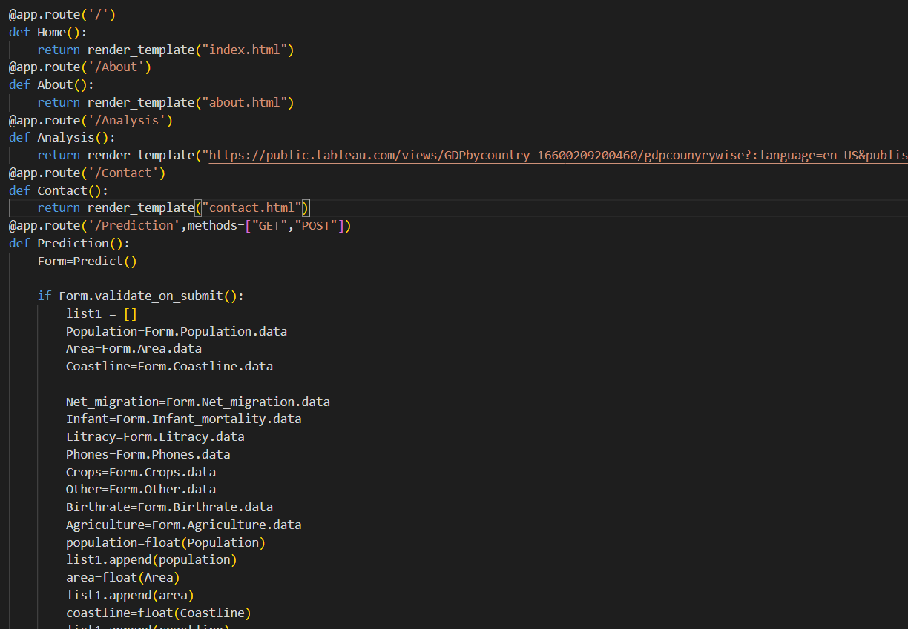
Deployment Code Sample

Slide 33
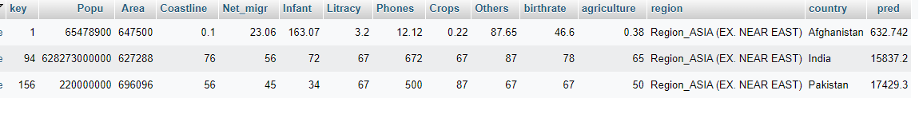
Database Connectivity
In FYP we also use MySQL database which will store data for future use.
Result of Database

Slide 34
User Interface
We used HTML, CSS, JavaScript, and Bootstrap5 for our website development.
We built a website which consists of 5 pages which are as follows:
Home
About
Analysis
Predictions
Contact us
The Visual representation of the website and its code will be shown in live demo.

Slide 35
Conclusion and Future Work
In our project we have made a GDP Per Capita Prediction System, which will predict the GDP per capita of a country.
The entire project has been developed and deployed as per the requirements stated.
After the completion of this system design, analysis, and prediction. It will save time and effort for decisions and provide guidelines to analysts to perform better in the future for the organization.
As a piece of Future work, it is recommended to add more information into a dataset and embeds year-wise information of those all credits in the dataset on which GDP per capita is reliant.
Attempt to do more analysis. Try to do analysis based on more attributes and by evaluating it with more algorithms.

Slide 36


